Slide 1



PUSL3190
Computing
Project
Plymouth Batch 09
Diluka Wijesinghe (diluka.w@nsbm.ac.lk)
Faculty of Computing | NSBM Green University

Slide 2



UI/UX Design

Slide 3



01
Foundation of UI/UX
02
Research & Empathy
03
Ideation & Architecture
04
Prototyping & Testing
05
Visual & Interaction Design
06
Real-World Impact

Slide 4

PART 01
Foundation of UI/UX

Slide 5
Defining UI vs. UX
Clarifying the distinction between the visual touchpoints and the complete journey.
+
User Interface (UI)
User Experience (UX)
Focuses on the visual elements: the look, feel, and interactivity. It includes screen layouts, visual design, and transitions.
Encompasses the end-user's entire interaction with a product or service. It's about the overall experience and journey.
Goal: Create an aesthetically pleasing and intuitive interface.
Goal: Make a product useful, usable, and enjoyable.
Together, they create products that are both beautiful and functional .

Slide 6
Human-Centered Design Cycle
A process that starts with the people you're designing for and ends with new solutions that are tailor-made to suit their needs.
Empathize
Ideate
Define
Test
Understand the needs and context of the people you are designing for.
Generate a wide range of creative solutions to address user needs.
Clearly articulate the problem you are trying to solve based on insights.
Gather feedback by testing prototypes with real users to refine the solution.

Slide 7
The Psychology of Interaction
Understanding how users think is key to designing effective interfaces. Cognitive psychology governs interface clarity and user satisfaction.
Mental Models
Users have preconceived notions of how things work. Design should align with these expectations to avoid confusion.
Cognitive Load
Minimize the amount of mental effort required to use your product. Simplify tasks and present information clearly. Overloading users leads to frustration and errors.
Hick's Law
Gestalt Principles
More choices increase decision time. Keep options focused.
Use proximity, similarity, and closure to organize UI.

Slide 8
PART 02
Research & Empathy

Slide 9
User Research Methods
Cataloging techniques to ensure design decisions are grounded in evidence, not opinion. Triangulation of data validates assumptions.
Quantitative Methods
Qualitative Methods
Answer "what," "where," and "how much" to quantify user behavior and spot patterns.
Answer "why" and "how" to uncover user motivations, pain points, and mental models.
Surveys: Gather broad feedback on attitudes and satisfaction from large groups.
Interviews: Gain deep insights into user experiences, needs, and frustrations.
Analytics: Track user behavior, conversion rates, and feature usage.
Contextual Inquiry: Observe users in their natural environment to see real-world usage.
A/B Testing: Compare two versions of a design to see which performs better.
Card Sorting: Understand how users categorize information to inform IA.

Slide 10

Creating Data-Driven Personas
Synthesize field data into archetypal personas. These fictional, yet research-based profiles align product requirements and prioritize features.
Maria Rodriguez
The Busy Product Manager
Goals: Quickly find key insights to inform product decisions.
1
Research & Data Collection
Gather data from interviews, surveys, and analytics to find patterns in user behavior and demographics.
Frustrations: Clunky interfaces that slow her down. Data is hard to export.
Behaviors: Uses mobile app during commute, desktop during the day. Values speed and reliability.
2
Identify Behavioral Patterns
Group users with similar goals, needs, and behaviors to form the basis of each persona.
Quote: "I need tools that work as fast as I do."
3
Create Persona Profiles
Give each persona a name, photo, and a detailed narrative that highlights their goals, frustrations, and context.

Slide 11
Journey Mapping Pain Points
Visualize the end-to-end customer journey to reveal gaps and opportunities for thoughtful UI interventions.
Discover
Explore
Purchase
Use
Advocate
User searches for a solution to their problem.
User visits your site and browses products.
User adds to cart and attempts checkout.
User receives and uses the product.
Happy user recommends to others.
Pain Point: Overwhelmed by choices.
Pain Point: Can't find details.
Pain Point: Checkout is too long.
Delight: Easy to set up!
Goal: Loyalty & Advocacy

Slide 12
PART 03
Ideation & Architecture

Slide 13
From Stories to User Flows
Translate requirements into narrative user stories, then diagram task flows to streamline interaction and reduce abandonment.
User Story
User Flow Diagram
"As a [user], I want to [action], so that [benefit]."
A simple, non-technical description of a feature from the user's perspective.
Search
Save to Wishlist
View Wishlist
Example: "As a customer, I want to save items to a wishlist, so I can purchase them later."
A visual representation of the path a user takes to complete a task, charting decision nodes and alternate paths.

Slide 14
Information Architecture
Example: E-commerce Site IA
Organizing, structuring, and labeling content so users can find information and move confidently through large data sets.
Hierarchy & Taxonomy
Homepage
Create a clear, logical structure. Use categories and subcategories that make sense to users.
Labeling & Metadata
Use clear, concise, and consistent labels. Metadata helps with search and filtering.
Shop by Category
Deals
Support
Navigation Patterns
Provide clear and consistent navigation so users always know where they are and how to get back.

Slide 15
Low-Fidelity Wireframing
Lo-Fi Wireframe Example
Start with grayscale wireframes to focus on layout, priority, and functionality without aesthetic distraction. This enables rapid iteration and early usability testing.
Rapid Iteration: Quick to create and modify, allowing for more design exploration.
Better Feedback: Keeps stakeholders focused on user value and structure, not color debate.
Cost-Effective: Saves costly rework later in the development process.

Slide 16
PART 04
Prototyping & Testing

Slide 17
Interactive Figma Prototypes
Convert static frames into clickable prototypes using Figma's smart animate and overlay features. This allows for realistic user testing and clear communication with developers.
Clickable Hotspots
Smart Animate
Link frames together to simulate navigation and user flows.
Create smooth transitions between states for a realistic feel.
Interactive Components
Build components with variants for toggles, buttons, and menus.

Slide 18
Usability Testing Facilitation
A structured approach to observing real users and gathering feedback to drive design refinements and prove ROI.
1. Recruit
2. Plan
3. Facilitate
4. Analyze
5. Iterate
Find participants that match your persona profiles.
Define tasks, success metrics, and a moderator script.
Use the think-aloud technique and observe without bias.
Identify patterns, pain points, and areas for improvement.
Feed findings back into the design process to refine the solution.

Slide 19
Heuristic Evaluation Toolkit
Expert reviews quickly detect usability issues, supplementing user tests to ensure both expert compliance and user satisfaction.
Nielsen's 10 Heuristics
Accessibility Checkpoints
Visibility of system status
Recognition over recall
Ensure the product is usable by people with the widest range of abilities. Key checks include:
Match system & real world
Flexibility & efficiency
User control & freedom
Aesthetic & minimalist
Keyboard Navigation: Can all functions be accessed without a mouse?
Consistency & standards
Help users recognize errors
Error prevention
Help & documentation
Screen Reader Compatibility: Is the content structured logically for assistive tech?
Color Contrast: Do text and background colors meet WCAG ratios?
Text Alternatives: Do images have descriptive `alt` text?

Slide 20
PART 05
Visual & Interaction Design

Slide 21
Typography & Readability
Visual Hierarchy Example
Typographic clarity reduces eye strain, accelerates scanning, and strengthens brand voice. It's about more than just choosing a pretty font.
Main Title (H1)
48px Bold - The most important heading on the page.
Subheading (H2)
Hierarchy & Scale
32px Semibold - Used for main sections.
Use a clear visual hierarchy with distinct sizes for H1, H2, H3, and body text. A ratio of 1:1.5:2 is a good starting point.
Section Title (H3)
24px Semibold - For sub-sections and key points.
Line Length & Spacing
This is the body text. It should be easy to read and scan. A comfortable font size (16-18px) and line height are crucial for a good user experience. This is where the majority of your content will live, so its readability is paramount.
Keep line length between 50-75 characters for optimal readability. Ensure adequate line height (1.4-1.6x font size).
WCAG Contrast
Ensure a contrast ratio of at least 4.5:1 for normal text and 3:1 for large text to be accessible to users with low vision.

Slide 22
Color Psychology & Systems
Explore cultural meanings and emotional impact while ensuring accessibility through systematic color token usage.
Psychology & Meaning
Systematic Color Tokens
Blue: Trust, Security, Calm (Finance, Tech)
A scalable system ensures consistent branding and accessibility across themes.
Yellow: Optimism, Clarity, Warmth (Retail, Food)
B
Primary / Brand
Red: Excitement, Urgency, Passion (Sales, Entertainment)
Main brand color for key actions and accents.
Green: Growth, Health, Tranquility (Nature, Finance)
E
Error
For destructive actions and warning states.
S
Success
To confirm positive actions and completion.

Slide 23
Micro-interactions & Feedback
Examples in Action
Small, functional animations that communicate system status, guide task completion, and inject delight, increasing perceived responsiveness and user trust.
Button Press Animation
Pull-to-Refresh Cue
The Four Parts
Trigger (initiates), Rule (defines action), Feedback (signals change), Loop (duration/repetition).
Haptic Confirmation
Purposeful Design
Every micro-interaction should have a clear purpose. Avoid gratuitous animations that slow down the user or distract from the task.
Success State Indicator

Slide 24
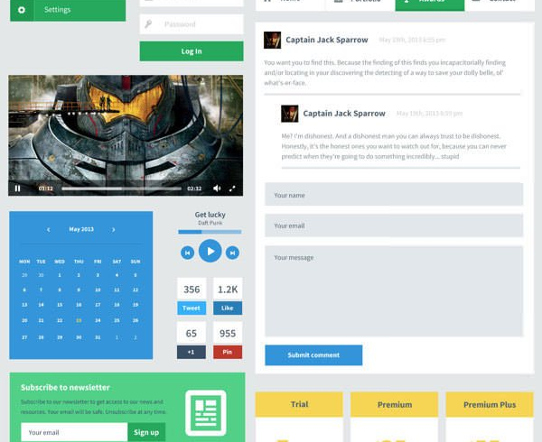
Component-Based Design Systems
A design system is a collection of reusable components guided by clear standards. It allows teams to build products faster and more consistently by assembling interfaces from documented building blocks.
Atoms:
Buttons, Inputs, Labels
Molecules:
Search Bar, Card
Organisms:
Header, Product Grid
Templates:
Page Layouts

Slide 25
PART 06
Real-World Impact

Slide 26
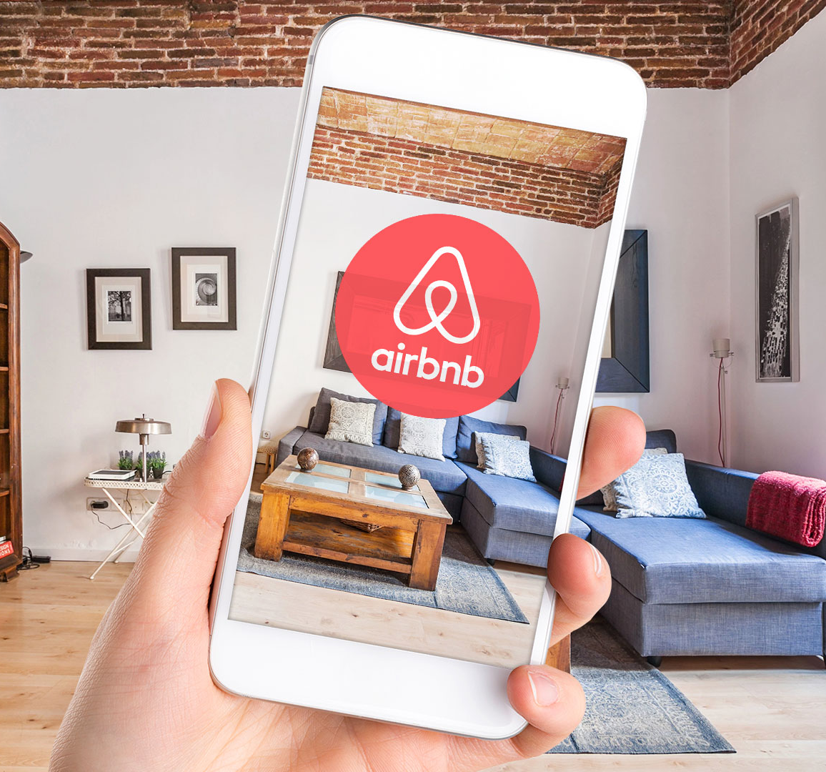
Case Study: Airbnb Redesign
Analyzing Airbnb's 2022 homepage overhaul that simplified search, elevated trust cues, and personalized recommendations.
The Challenge
The homepage felt cluttered, search was overwhelming, and users struggled to find relevant listings, leading to decision fatigue and lower conversion rates.
The Solution
A simplified search bar, larger imagery, clearer categorization, and the introduction of personalized "Categories" (e.g., Cabins, Beachfront) based on user data.
The Result
A measurable uplift in booking conversions and user satisfaction, proving the value of data-driven design and iterative prototyping.

Slide 27
The ROI of Design Systems
How companies like Uber, IBM, and Shopify leveraged centralized design systems for strategic advantage.
Accelerated Release Cycles
Brand Coherence
Cut Development Costs
A single source of truth ensures a consistent look and feel across all platforms and products.
Reduced UI bugs, faster onboarding for new developers, and less rework lead to significant savings.
Reusable components allow teams to build products faster, reducing time-to-market.
~50% Faster
100% Consistent
Millions Saved

Slide 28

Ethics & Inclusive Futures
The responsibility of designers to ensure technology remains humane, empowering, and socially beneficial for all.
Avoid Dark Patterns
Design with integrity. Do not trick users into taking actions they didn't intend to.
Respect Privacy
Champion user data protection and transparency in how information is collected and used.
Champion Inclusive Design
Accommodate users of all ages, abilities, and contexts, including low-bandwidth environments.
Foster Diverse Teams
Diverse perspectives lead to more innovative and equitable solutions. Encourage continuous education and impact audits.

Slide 29
THANKS!

